Slide 1
Identifying the Contribution of iPads through Mini-assessments
Cindy Malone, Biology
Mary-Pat Stein, Biology
Tae Kim, Jour
Stephanie Bluestein, Jour

Slide 2
Fall Biology iPad 2013
BIOL 106 – Introductory Majors (2 sections taught by Robertson, ≈ 250 students)
BIOL 107 – Introductory Majors (3 sections; 2 taught by Malone ≈ 250 students and 1 by Basu with ≈ 120 students)

Slide 3
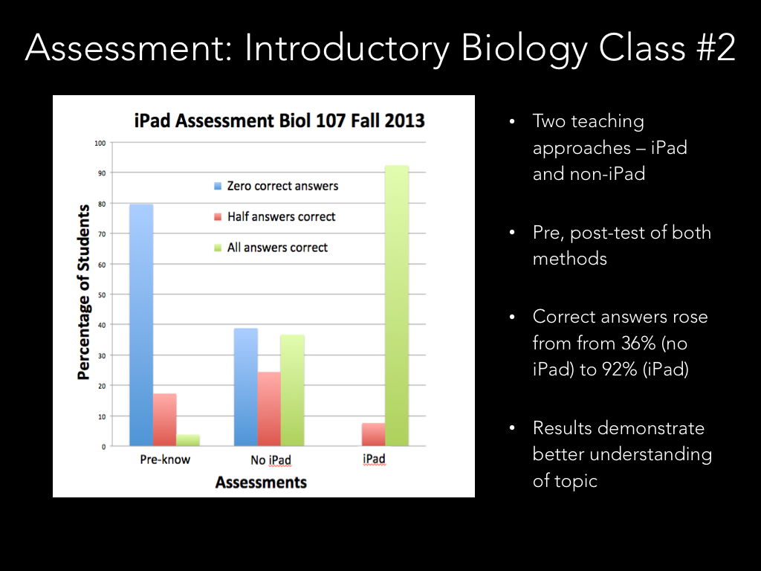

Slide 4
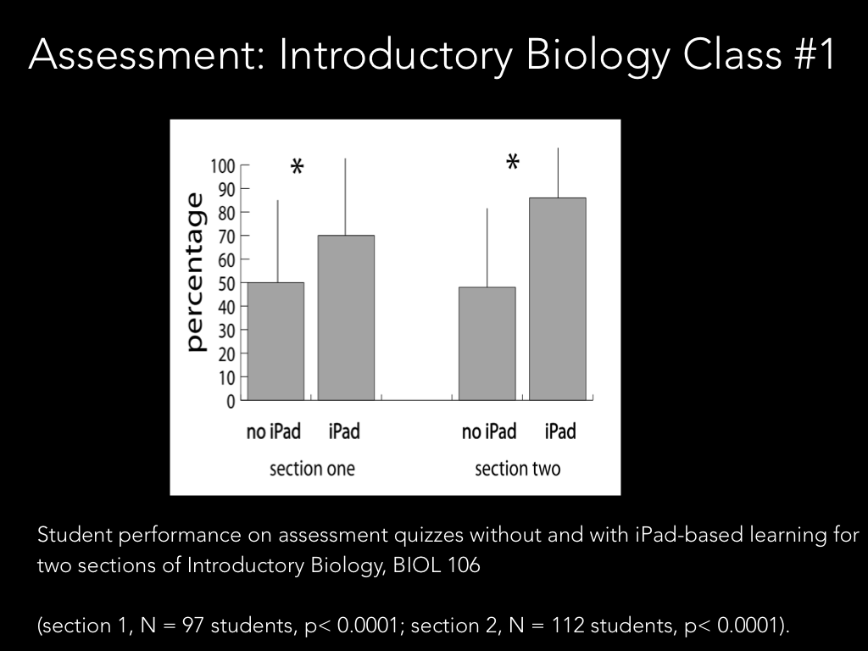

Slide 5
Spring 2014 Biology iPad Courses
Biol 106 – TerHorst and Beck (2)
Biol 107 – Jesu, Kay-Nishiyama and Stein**
Biol 322 – Gray and Schiffman**
Biol 360 – Odom and Malone**
Biol 380 – Kay-Nishiyama and Stein**
** doing assessments

Slide 6
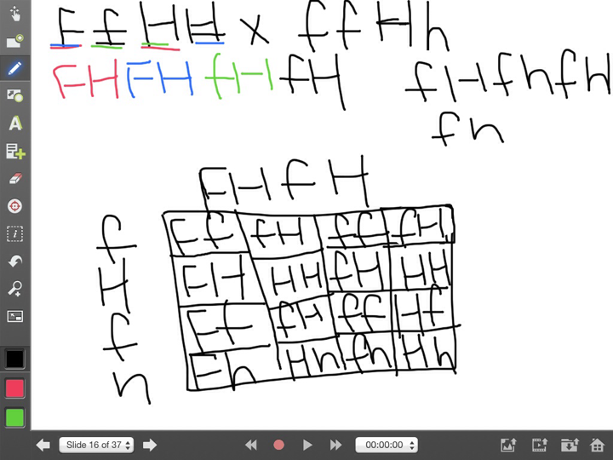
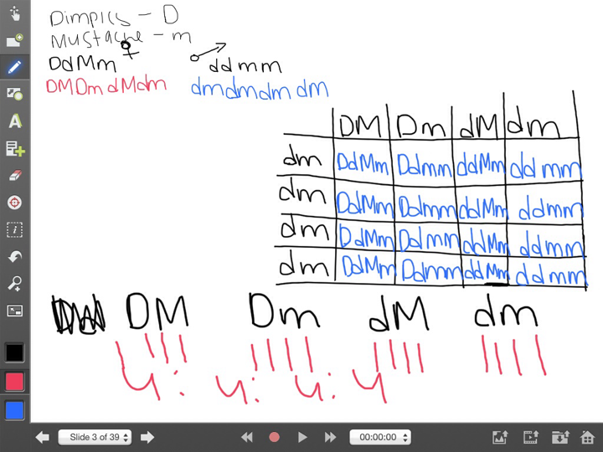
Two-Gene Punnett Square
Student 1 - first attempt with only PowerPoint instruction
Student 1 - second attempt after additional hands-on in-class practice

Slide 7
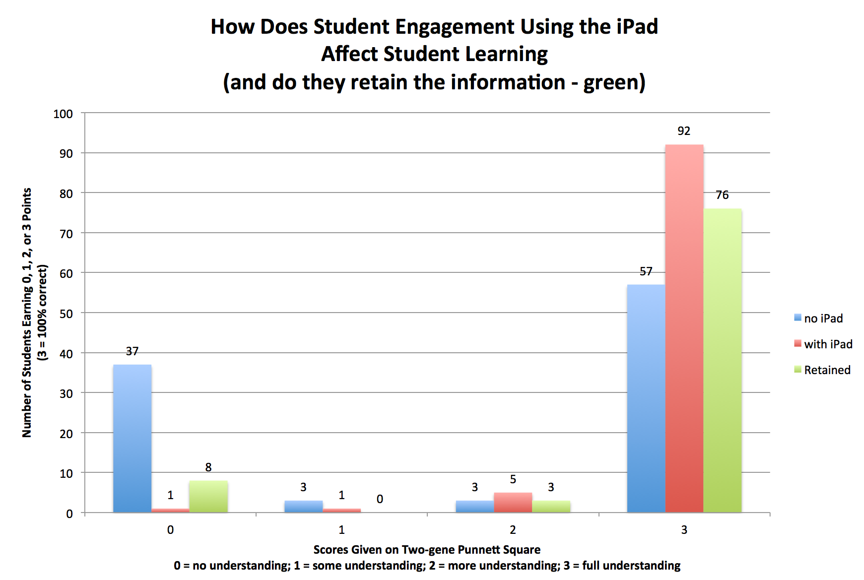

Slide 8
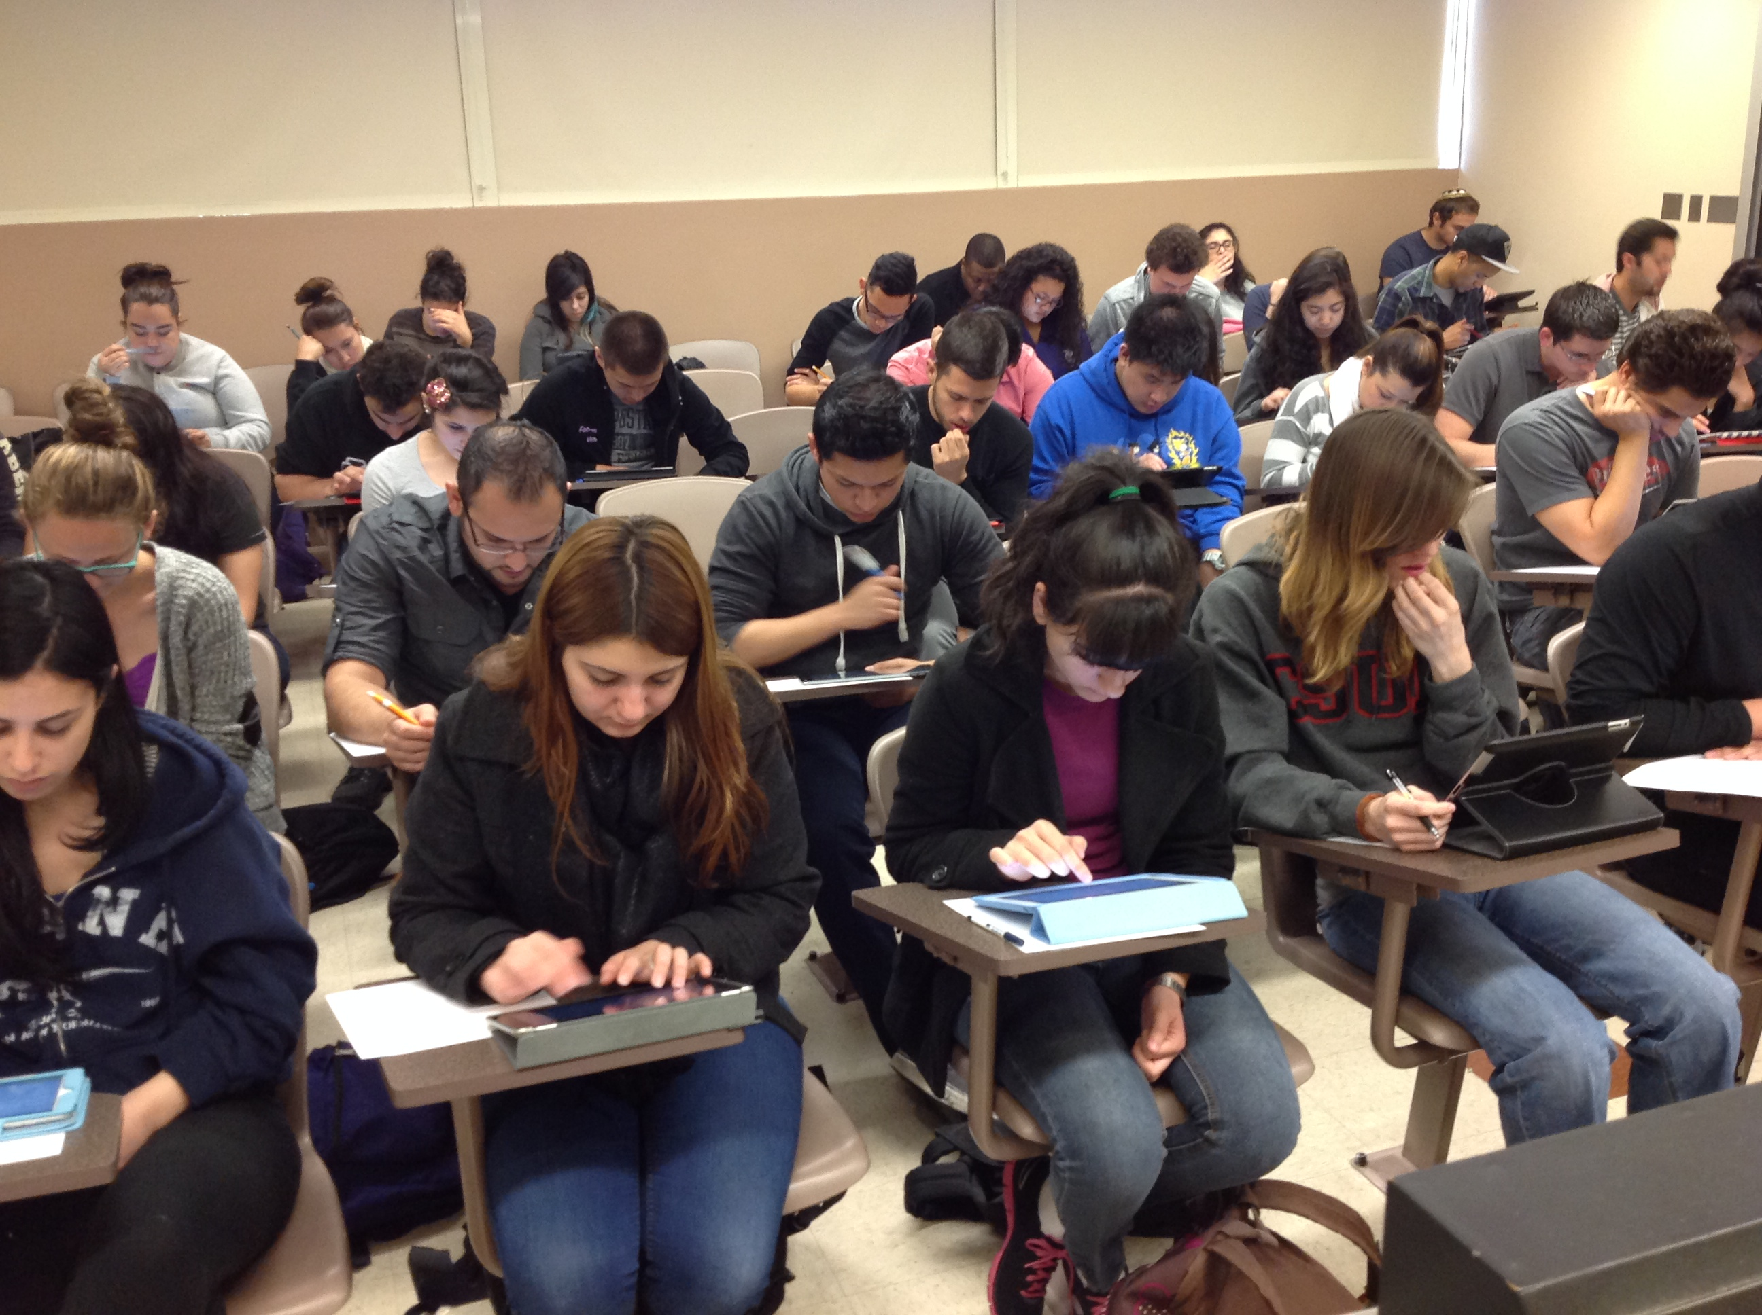

Slide 9
ExamSoft iPad Exams
App developed to prohibit cheating
Allows each exam to be unique (order of questions and order of answers)
Use Categories or Blooms taxonomy for back-end assessment
DRAWBACK - $$$ ($20/student/semester)
Currently Elizabeth Adams and Deone Zell are negotiating for site license or something in lieu of charging students

Slide 13
Stephanie Bluestein, Ed.D.
Taehyun Kim, Ph.D
Journalism Department

Slide 14
Research design: Jour 110 iPad
Pre-survey given Feb. 12, 2014
Post-survey given April 30, 2014
Unique ID numbers so that individual student responses can be tracked.
In-class writing assignments from Profs. Kim and Bluestein’s iPad sections will be compared to Profs. Kim and Walton’s non- iPad sections

Slide 15
Subject profile
First iPad class for all 16 students
81% female, 19% male
56% juniors, 19% sophomores, 25% freshmen
94% of students had a smart phone
31% owned an iPad before the class started
13% owned a non-Apple tablet
69% bought an iPad specifically for this class
In general, students had moderate range of iPad skills at beginning of semester.

Slide 16
How it was used in class
88% accessed course in Moodle, read the news, took a quiz, searched the Web
81% took photos with iPad
81% took notes for a class
81% read an eText or eBook
75% used course-related apps (Socrative, Nearpod most popular)
50% posted to social media for class, annotated a PDF, watched a captured lecture

Slide 17
Why did they enroll in the class?
40% signed up because it was an iPad class
60% didn’t know it was an iPad class
32% said they enrolled because of the prof
69% said they enrolled because of time/day
At beginning of semester, no one said they wished they hadn’t signed up for the iPad class.

Slide 18
Journalism-related

Slide 19

Overall learning

Slide 20
Student end-of-semester reflections
67% would enroll in a myCSUNtablet course again.
60% were satisfied overall with the course
69% would want iPads to be used if they took the course again.
48% said if they had to take the class again they would prefer no iPads.

Slide 21
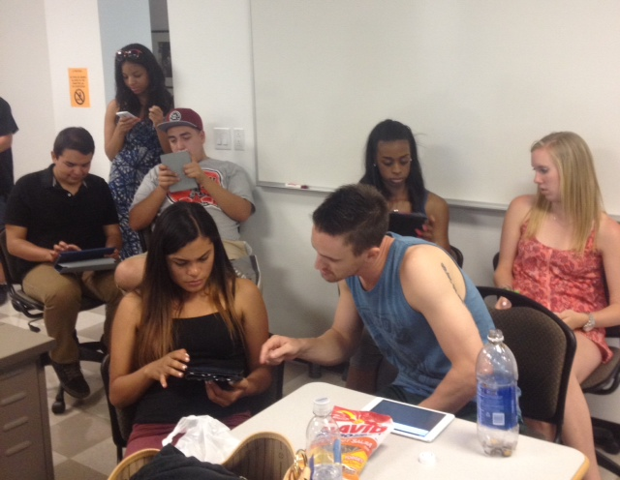

Slide 22
Researchers’ reflections
Exploratory survey
Longitudinal analysis will give us more useful information
Students used iPads in addition to computers already installed in our writing lab, so iPad's other impacts might have been suppressed or masked (as indicted in many written comments).
Promising interesting pattern is how iPad works better as a content consumption and collaboration tool than content creation (composition) tool.
Since we have ID numbers, we can do qualitative interviews with subjects later on.

Slide 23
HSCI 237- Introduction to Health Education iPad mini-assessment
Carla Valdez
Department of Health Sciences

Slide 24
Course Overview
First core course for Public Health Promotion students
3 sections of HSCI 237
  1 iPad
  2 traditional
Strategies:
  Provided skeletons of PowerPoint presentations to ipad section but not for non-iPad sections
    Available to students prior to class
  Used apps to take notes during lecture
  Use of tablets to facilitate small group activities and submission of class work
  Quiz/polling apps

Slide 25
Healthy People 2020 paper
All classes had a homework assignment
All students were required to select a topic area (health issue)
PowerPoint content was available to students on the iPad regarding the assignment (how to select a topic, criteria to look for, etc.)
  We completed an in-class activity that allowed for students to follow along with me as I demonstrated how to access content on the Healthy People site.
Students created a mini presentation (using the iPad) highlighting their chosen topic area and presented to small groups of peers.

Slide 26
Want more info?
Contact:
Cindy.malone@csun.edu
mpstein@csun.edu
Taehyun.kim@csun.edu
Stephanie.bluestein@csun.edu
Mary.valdez@csun.edu
Bonnie.paller@csun.edu
Deone.zell@csun.edu

